Slide 1
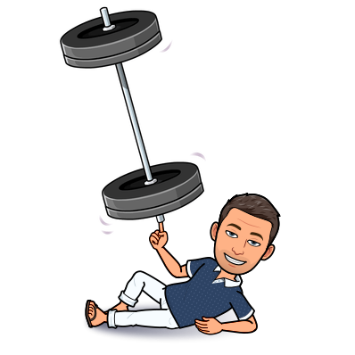
S.O.L.I.D principles

Slide 2


bad code / Good code
Bad code vs Good code
Categorize each piece of code

Slide 3
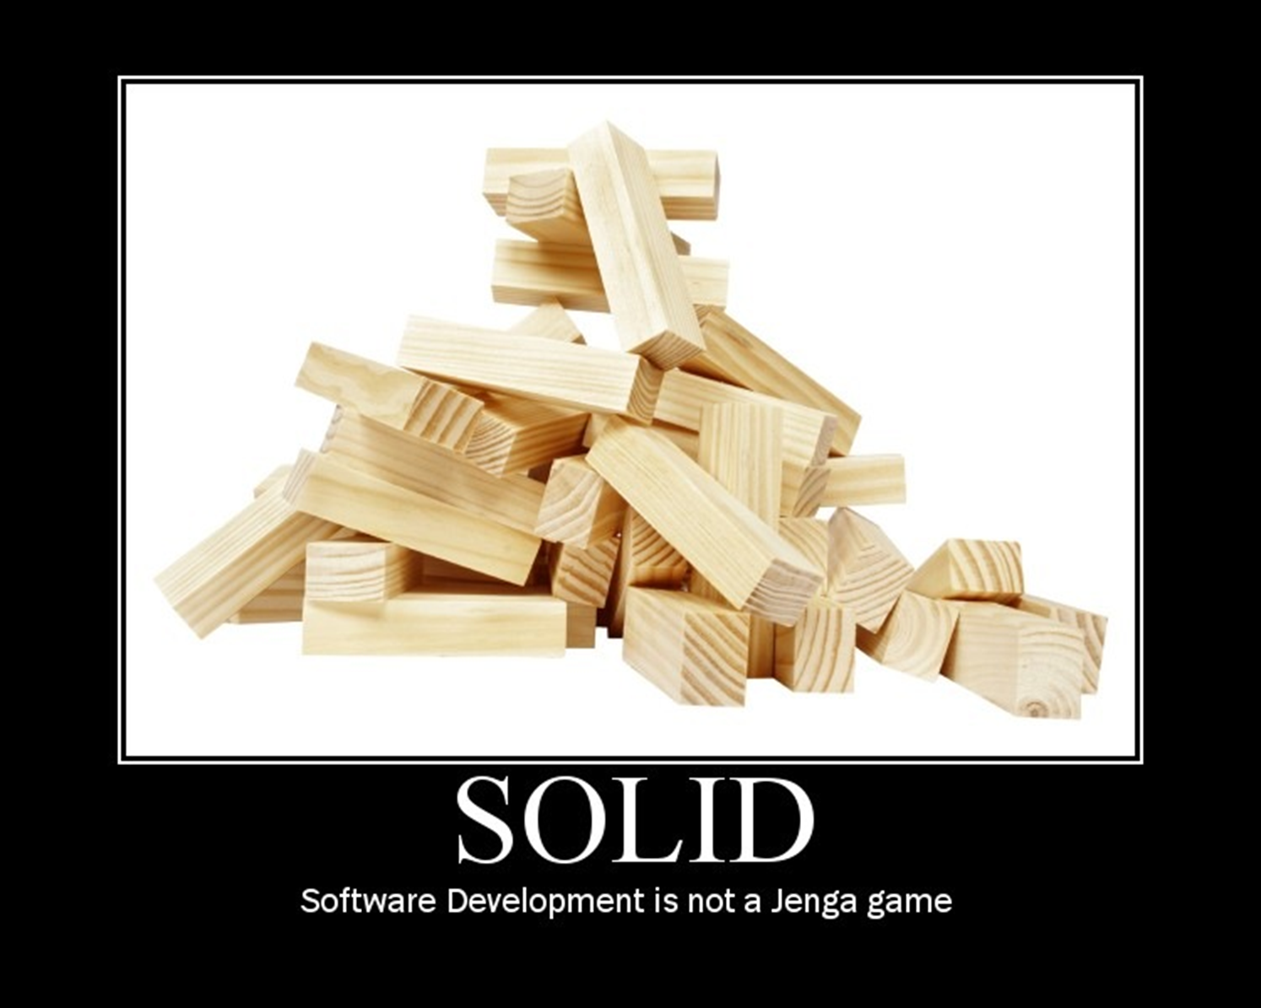

Slide 4
Patterns and anti-patterns
Singleton
Tight Coupling
Untestability
Premature Optimization
Indescriptive Naming
Duplication
Single Responsibility
Open/Closed Principle
Liskov Substitution
Interface Segregation
Dependency Inversion
Notes:
Can you guess ?
http://williamdurand.fr/2013/07/30/from-stupid-to-solid-code/
SRP - A class should have only one responsibility.
OCP - A software module (it can be a class or method ) should be open for extension but closed for modification.
LSV - Derived classes must be substitutable for their base classes.
ISP - Clients should not be forced to depend upon the interfaces that they do not use.
DIP - Program to an interface, not to an implementation.

Slide 5

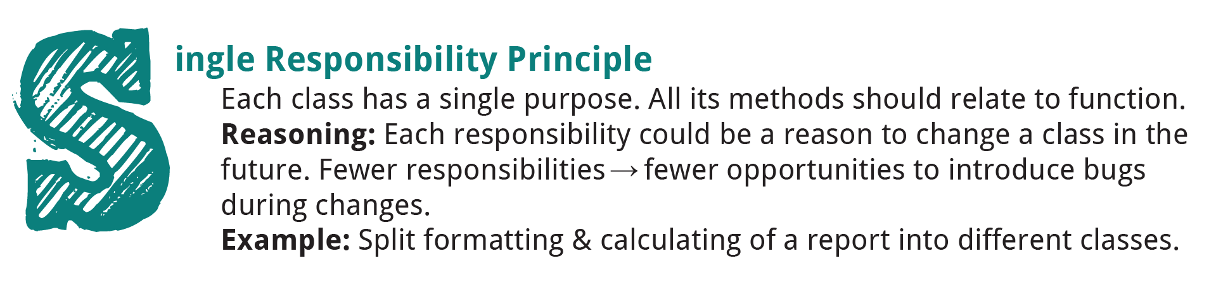
SRP
A class should have only 1 responsibility
Notes:
Some examples of responsibilities to consider that may need to be separated include:
Persistence
Validation
Notification
Error Handling
Logging
Class Selection / Instantiation
Formatting
Parsing
Mapping

Slide 6
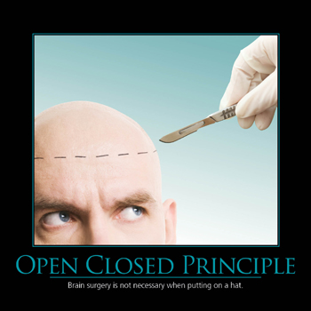
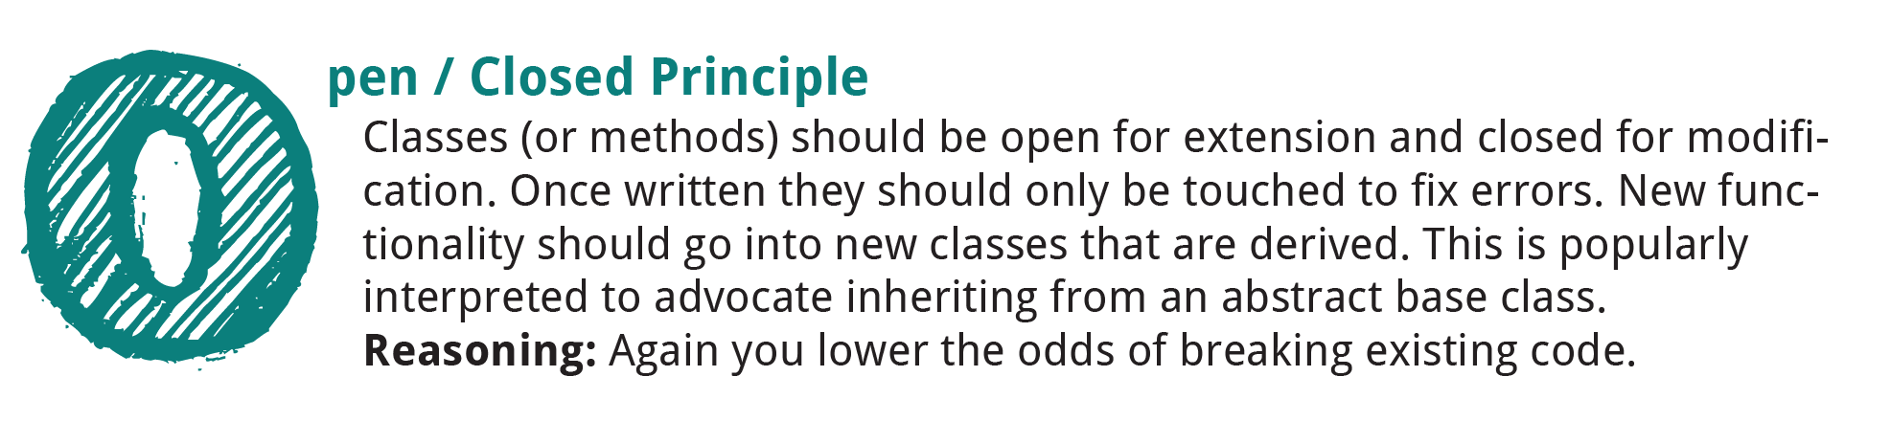
Open closed
Software entities should be open for extension,
but closed for modification.
Notes:
Creating software entities whose behavior can be changed without the need to edit and recompile the code itself.

Slide 7

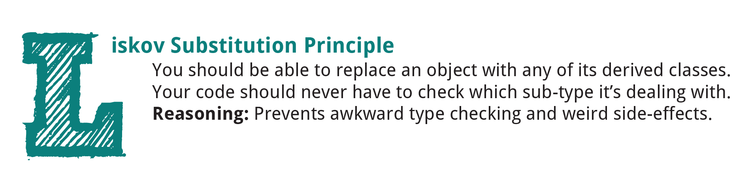
Liskov substitution
Should be able to replace an object with any of its derived class
Notes:
LSP violation : presence of type checking code within a code block that should be polymorphic.
S est un sous-type de T, alors tout objet de type T peut être remplacé par un objet de type S sans altérer les propriétés désirables du programme concerné.

Slide 8
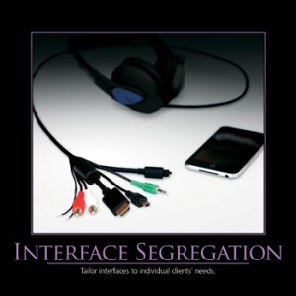
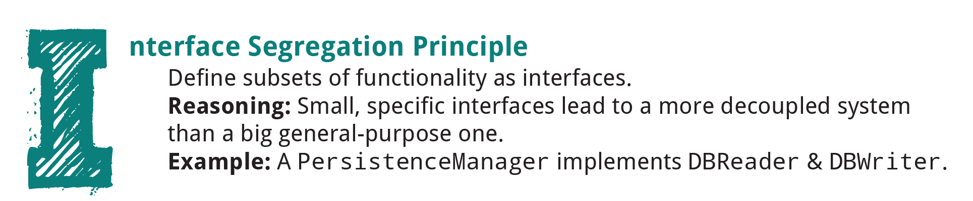
Interface segregation
Clients should not be forced to depend on methods that they do not use.
Notes:
Favor thin, focused interfaces to “fat” interfaces

Slide 9
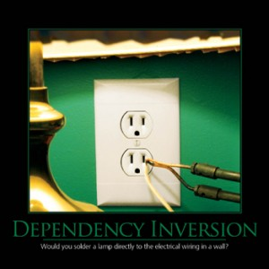
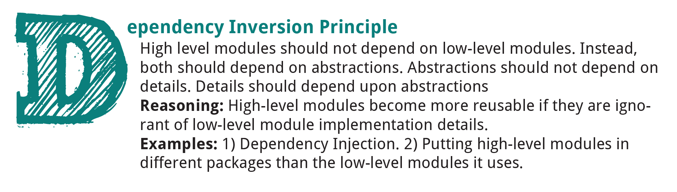
DI
High level modules should not depend on low level modules : both should depend on abstractions.
Notes:
Abstractions should not depend on details.
Details should depend upon abstractions.

Slide 10

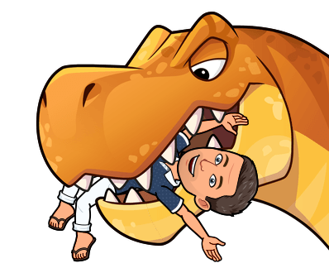




Good code / bad code
Align each piece of code with a S.O.L.I.D principle

Slide 11
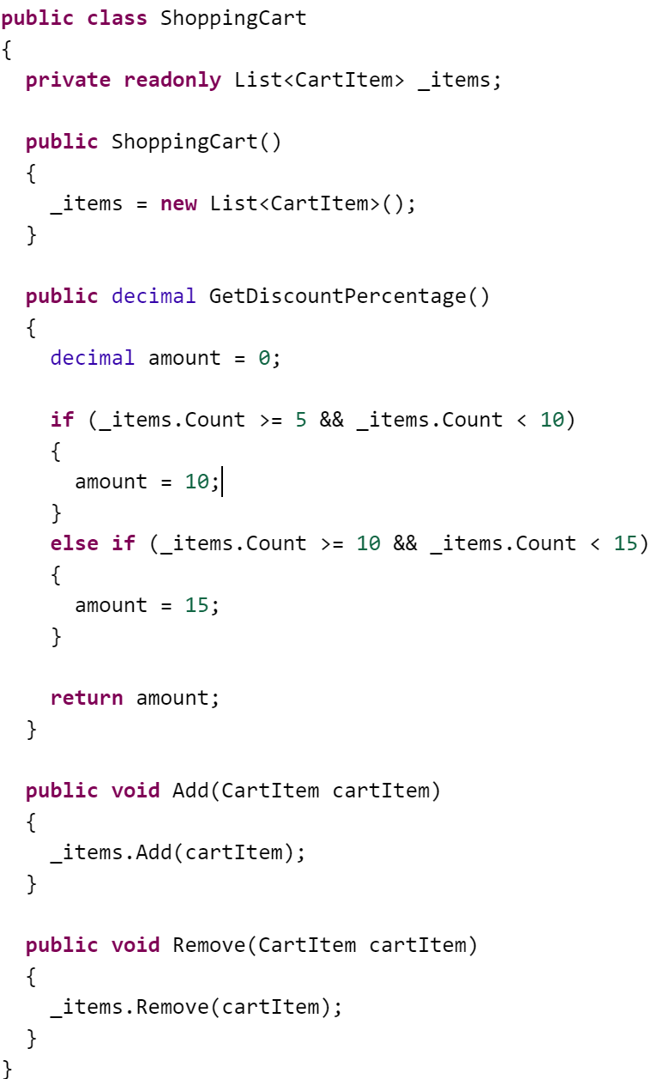
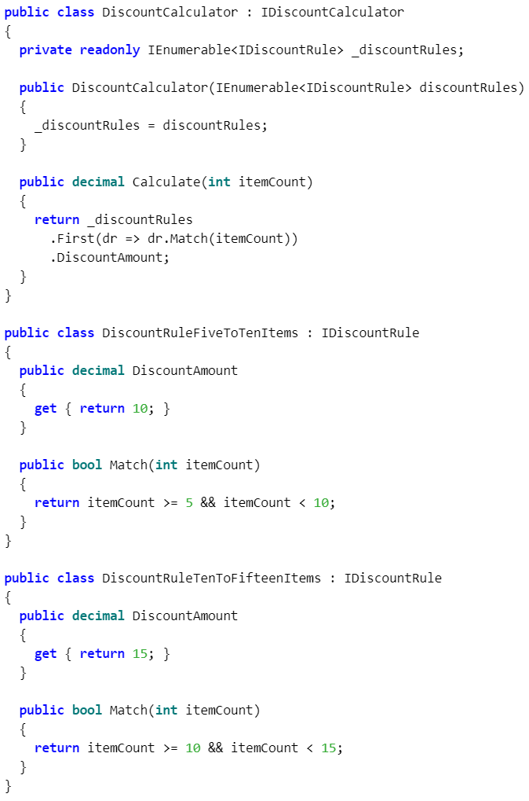
3
1
3

Slide 12
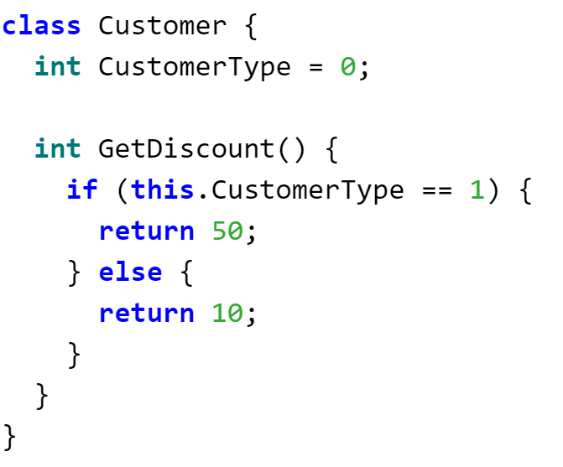
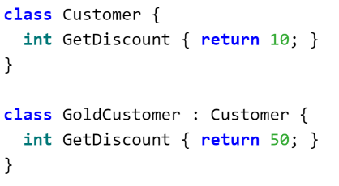
3
16
13

Slide 13
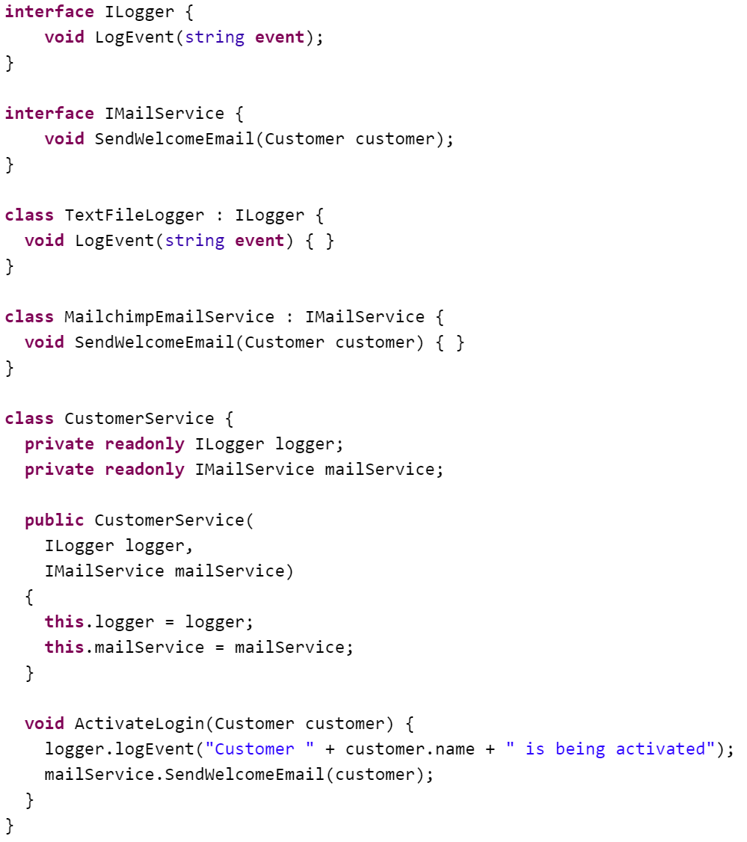
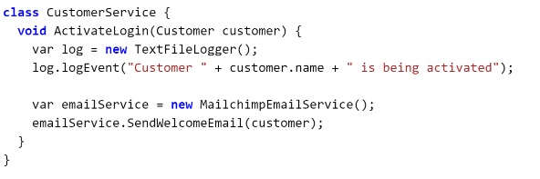
3
2
4

Slide 14
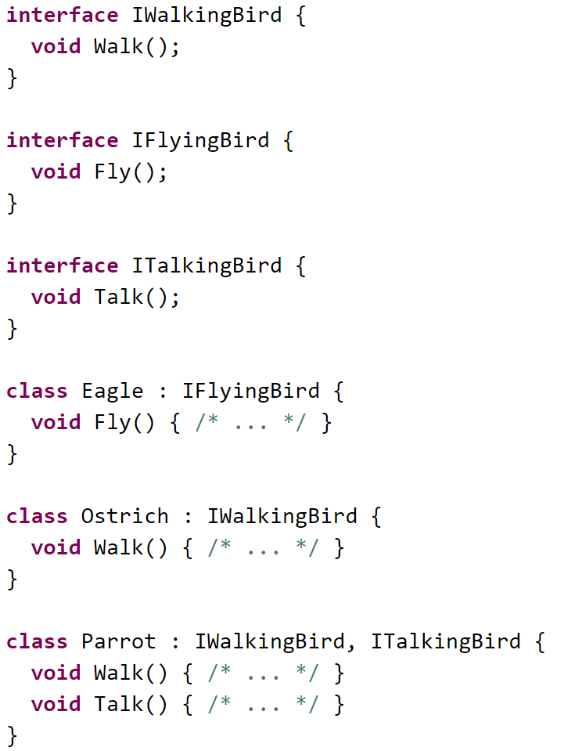
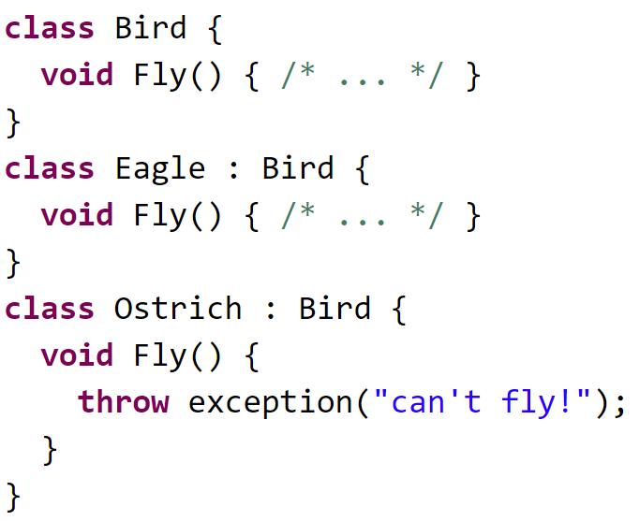
3
14
15

Slide 15
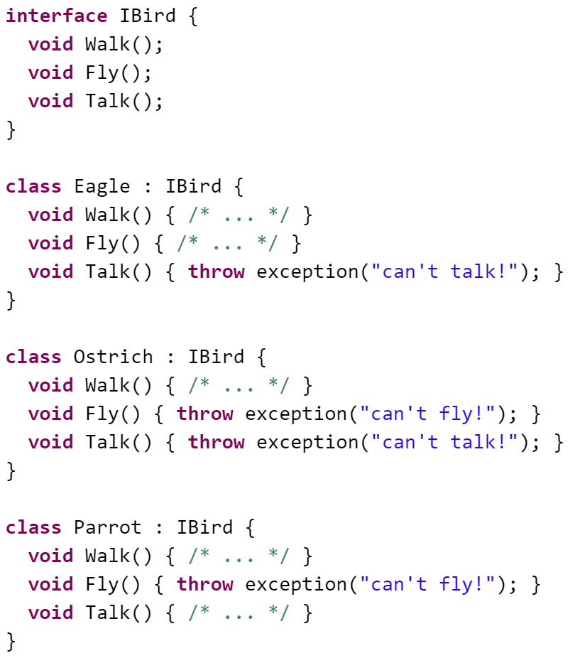
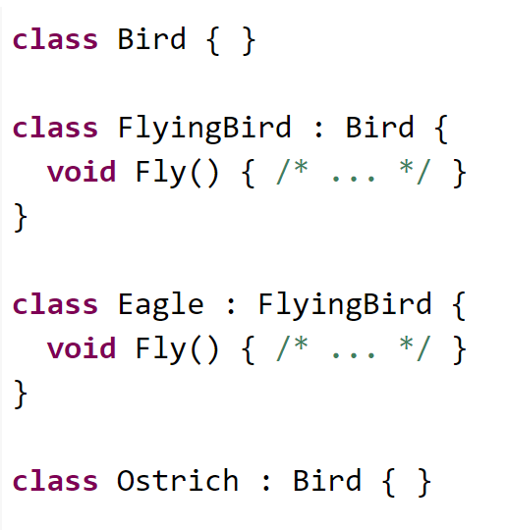
3
6
8

Slide 16
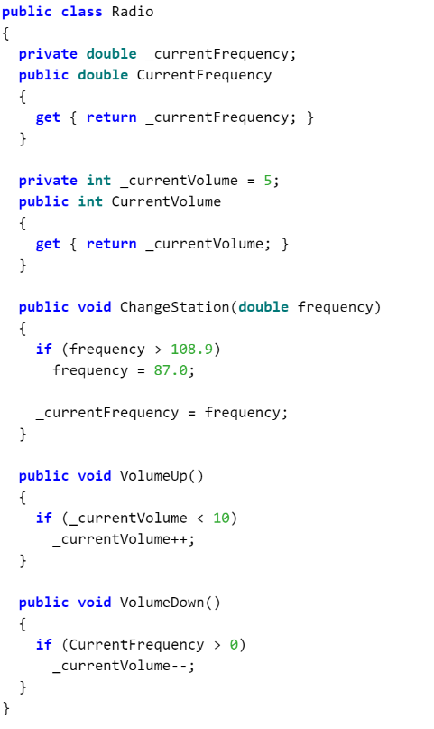
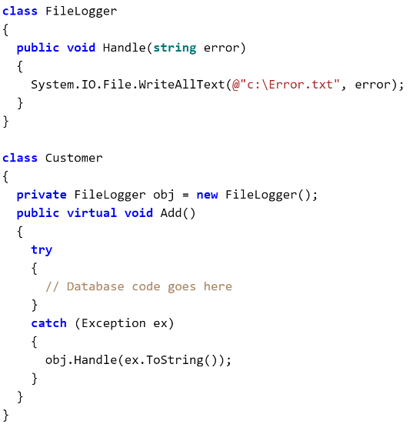
3
9
11

Slide 17
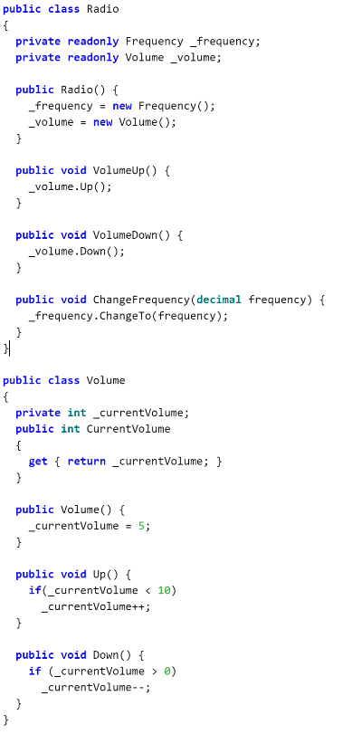
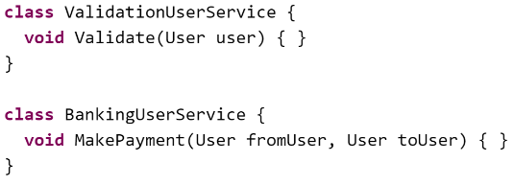
3
5
10

Slide 18
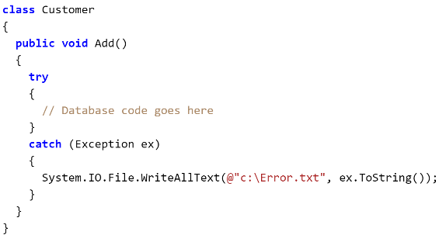
12

Slide 19
9
12
5
10
11
1
16
3
13
14
6
8
15
2
4

Slide 20

Let’s refactor using s.O.L.I.D

Slide 21

exercises
Practice S.O.L.I.D principles on code examples
Clone the repository at : https://github.com/ythirion/solid-kata
Foreach code example :
identify why it’s breaking the given principle
Write down your refactoring strategy
Refactor it

Slide 22

Stop solid be cupid ?
https://speakerdeck.com/tastapod/cupid-for-joyful-coding

Slide 23
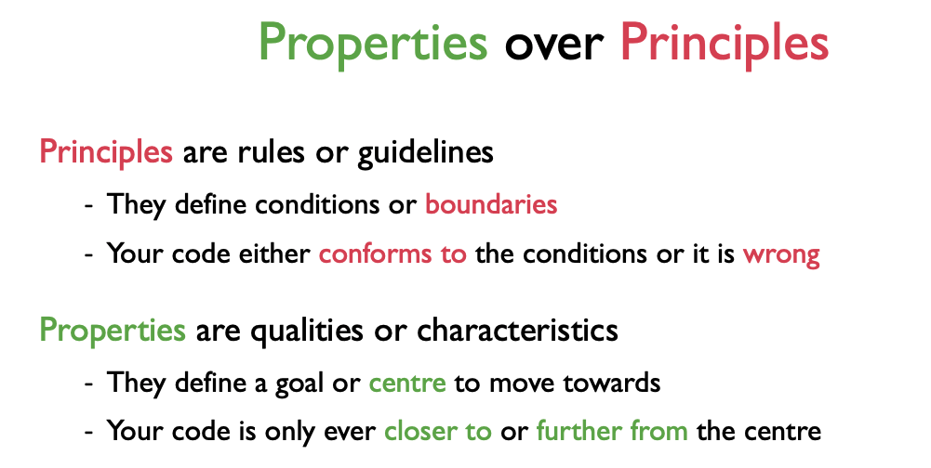
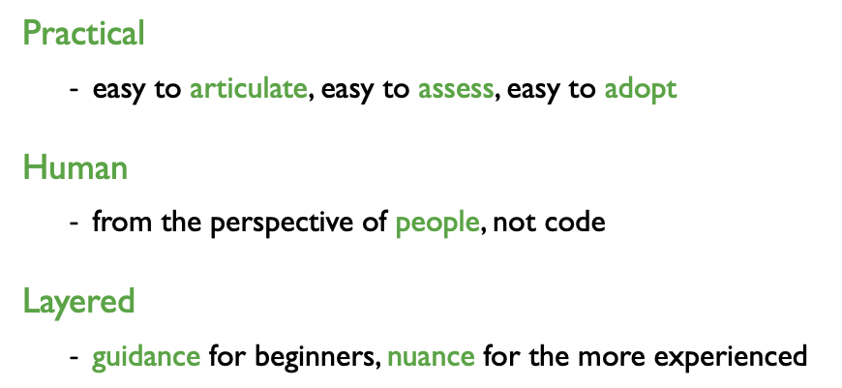

Slide 24
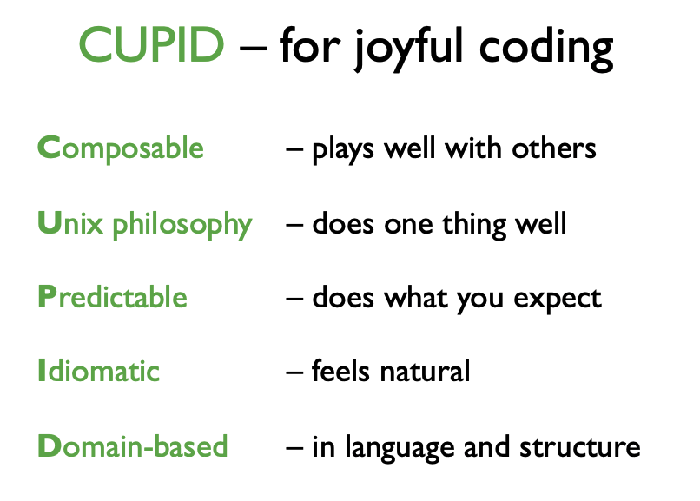

Slide 25
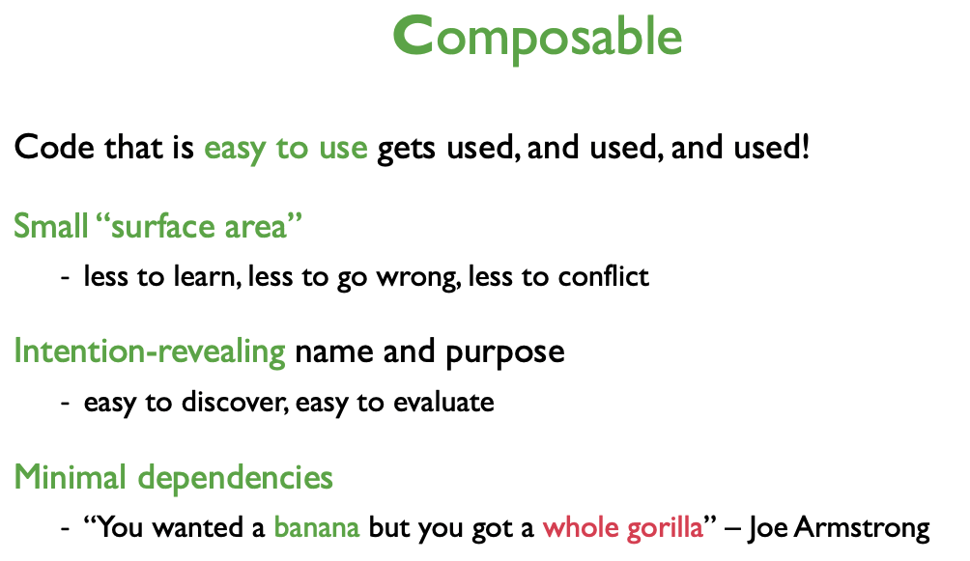
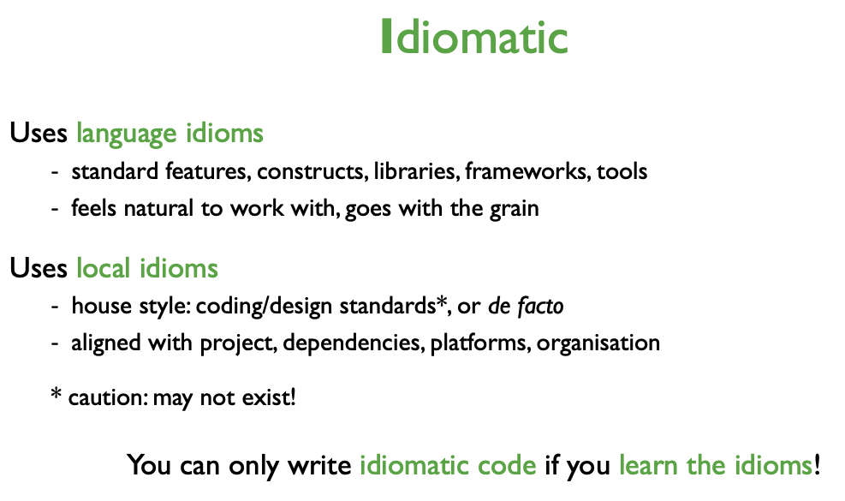
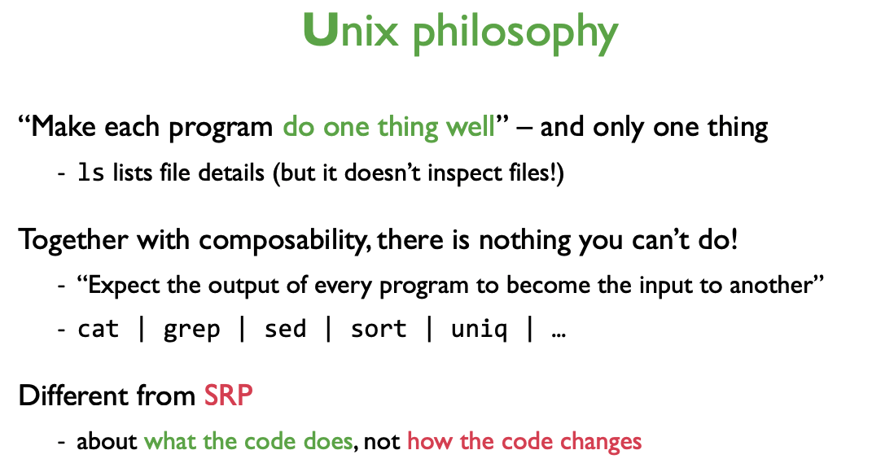
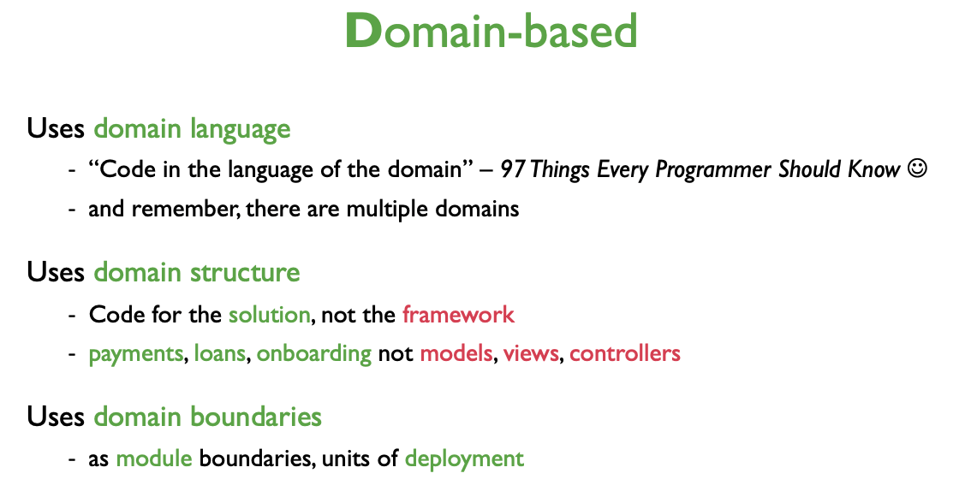
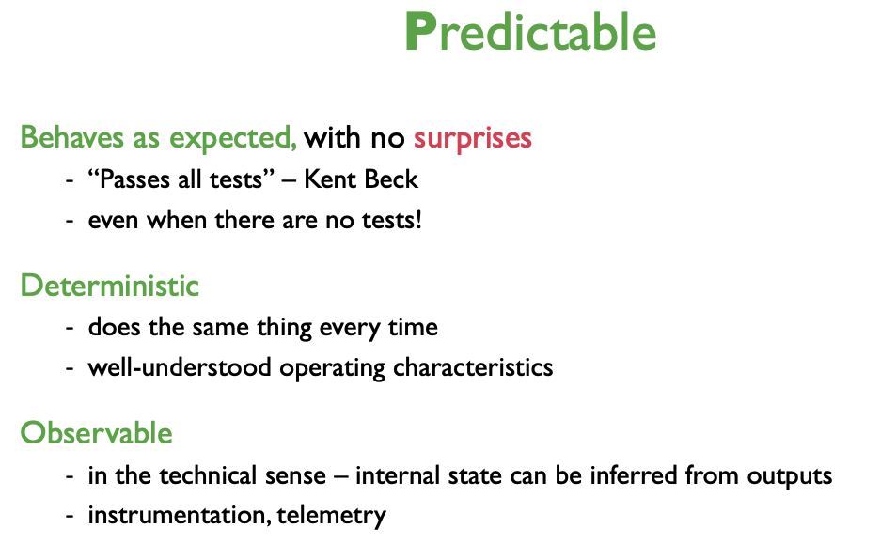

Slide 26

Where do you stand ?
On the way
No quite yet
Ready to roll
Notes:
3 level of training application
Think about what you have learned, assess your level of readiness to use what you’ve learned
Stand where you have chosen
In pairs : If you are standing in the
“not quite yet” : what will it take for you to move to “on the way”
“on the way” : what will it take for you to move to “ready to roll”
“ready to roll” : what will it take for you to move to continue learning
Ask for verbal summaries of what they discussed

